Slide 1
BARC Tube Bending Week 3

Slide 2
Checklist
Process: Manual Edge detection Smoothing edges Fitting lines to straight sections Angle Calculation Part 1 ( Bends 1 & 2) Part 2 ( Bends 2,3 & 4) Automated Edge detection Smoothing edges Fitting lines to straight sections Angle Calculation Part 1 ( Bends 1 & 2) Part 2 ( Bends 2,3 & 4) | Varying Parameters: Background Color Background Brightness Distance to LED box Height of camera Camera Orientation Lighting (Front vs Back) Different cameras/lenses Adding noise (non-ideal lighting conditions) No. of Cameras

Slide 3
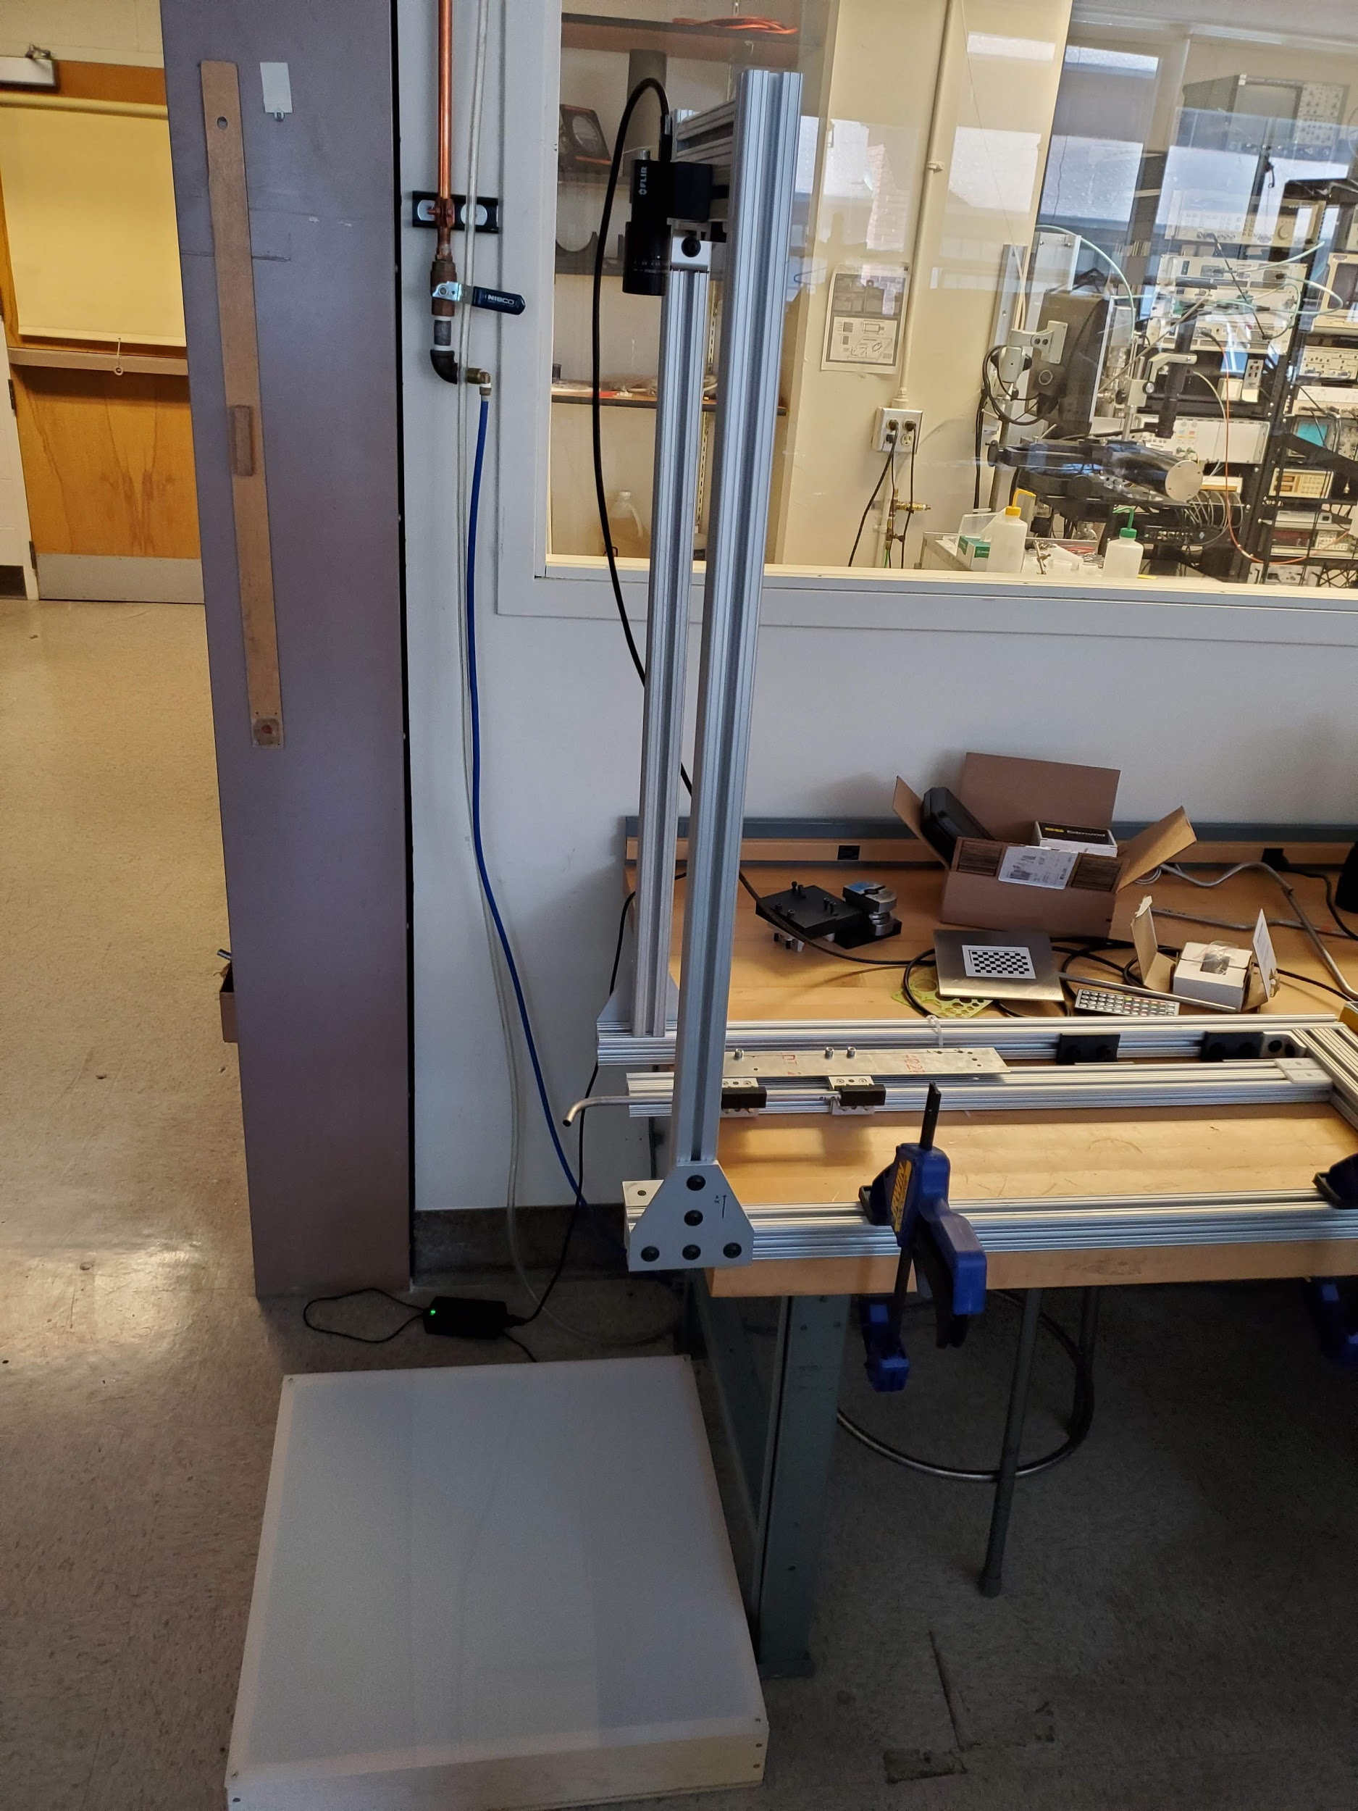
Setup
Camera
The setup shown is the idealized version of what would be implemented in a factory setting.
Here we can control background lighting and get very clear images.
Bend of Tube
LED box for lighting

Slide 4
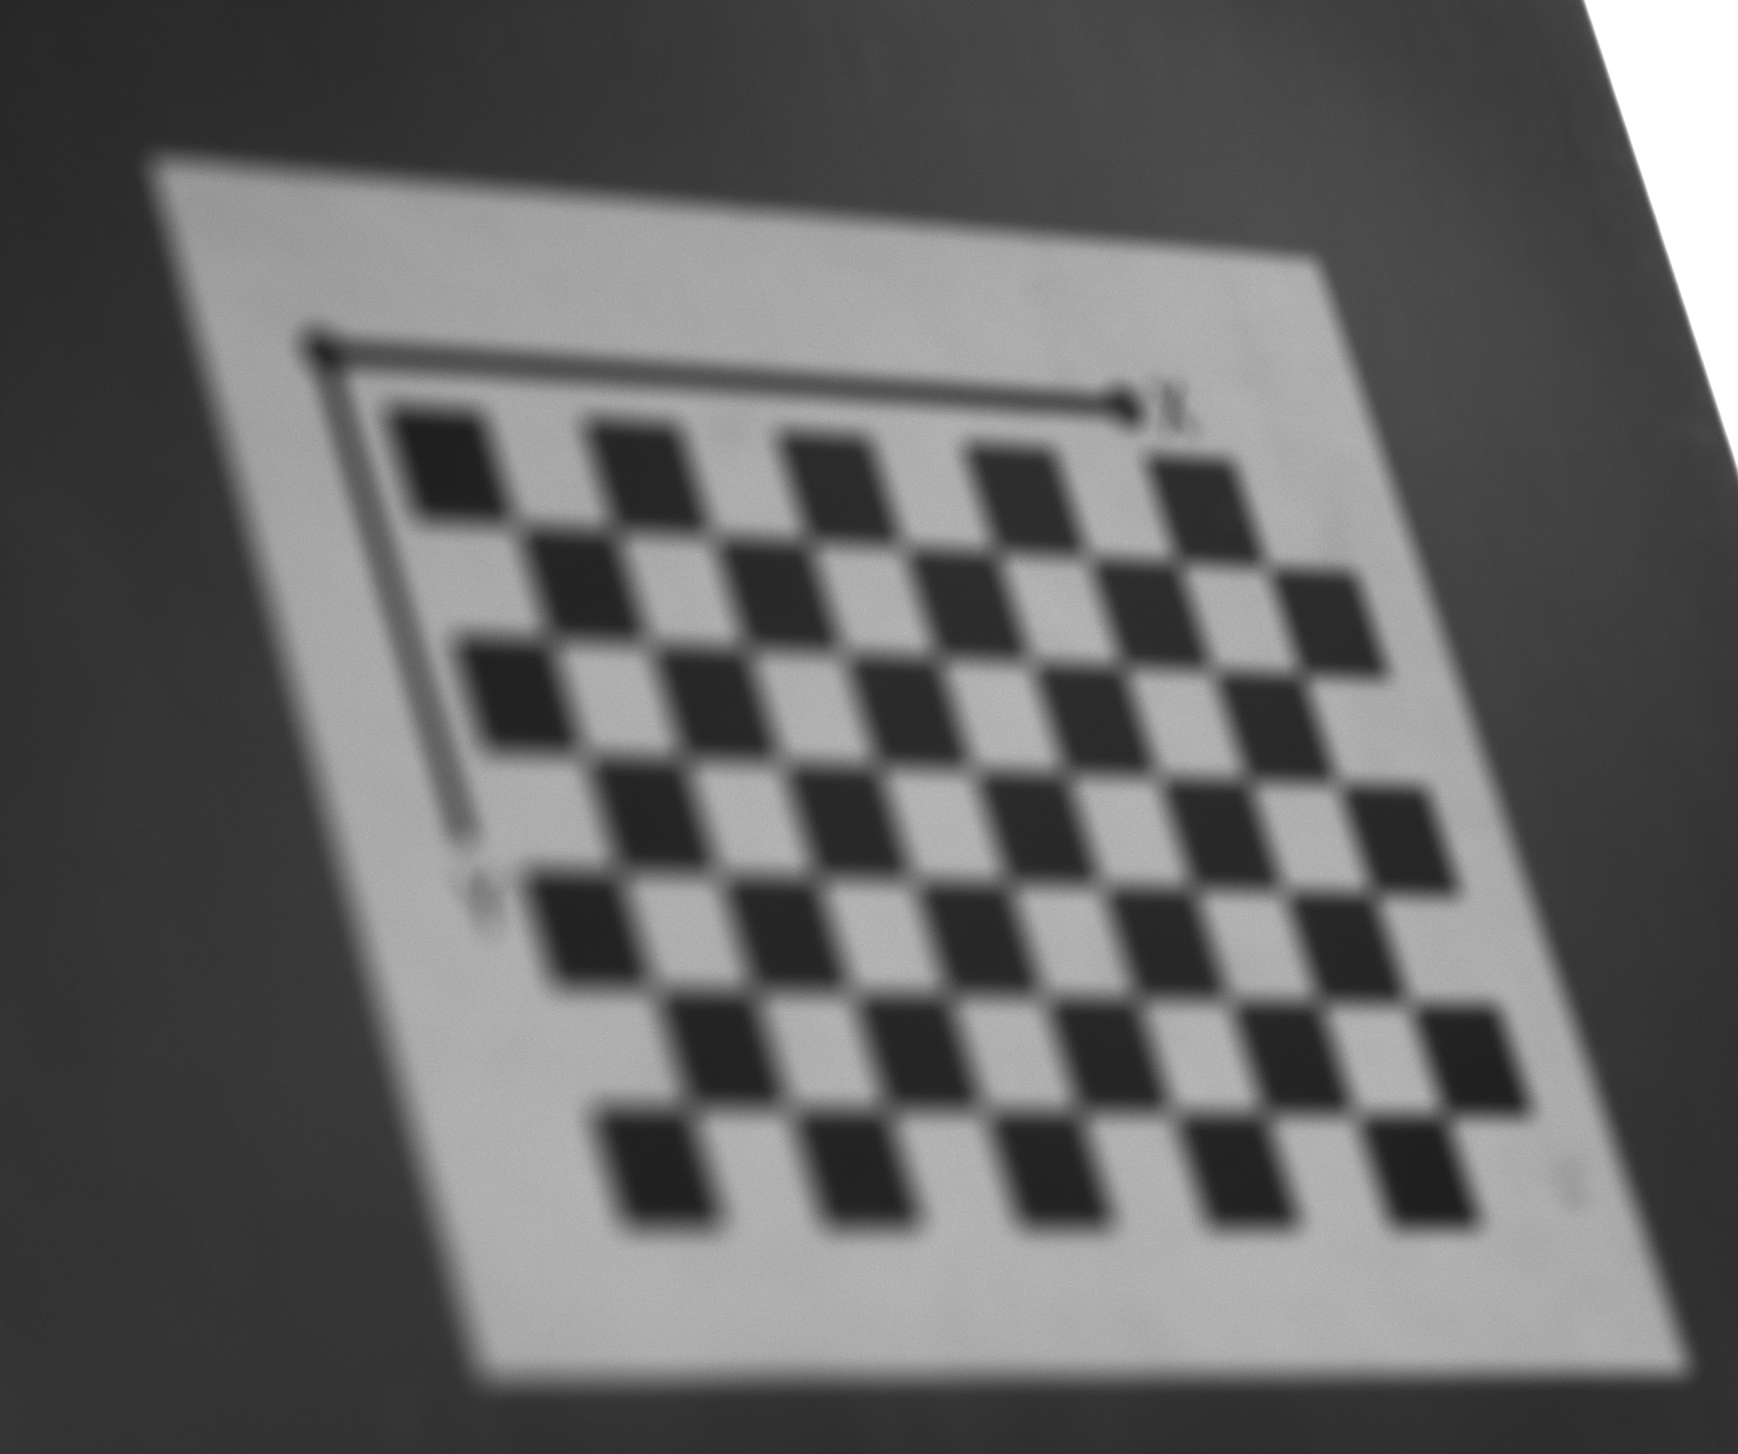
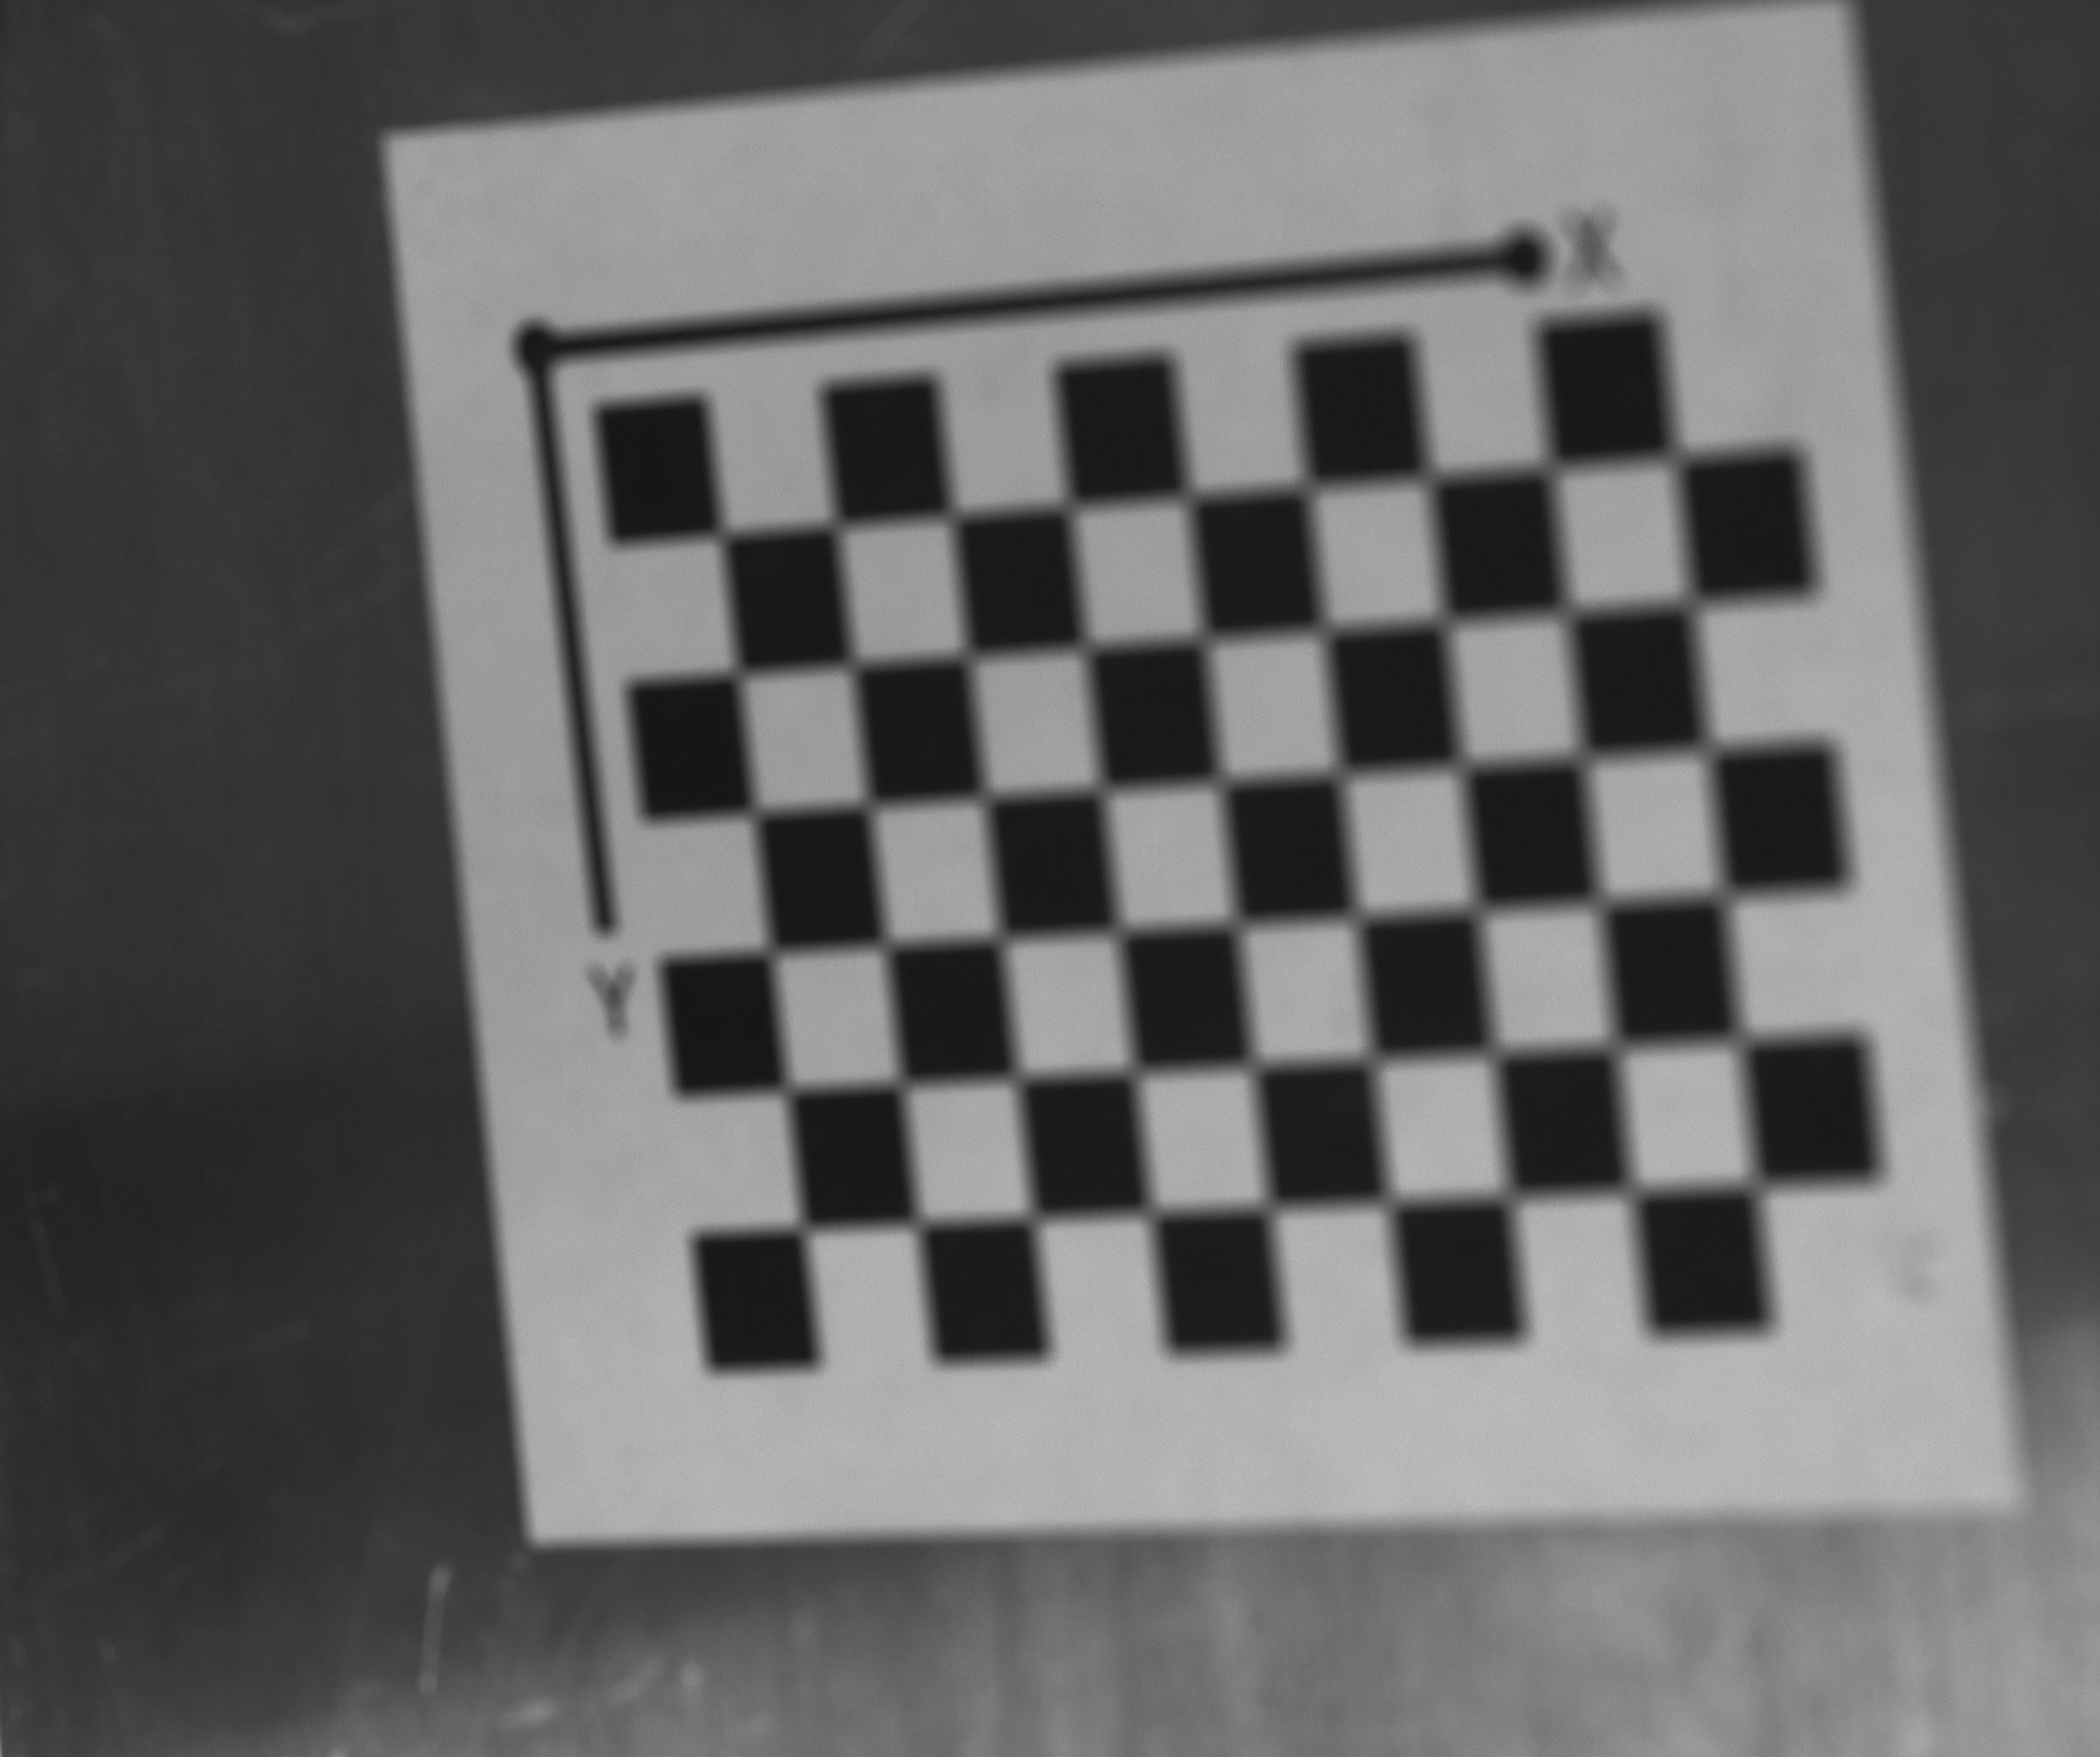
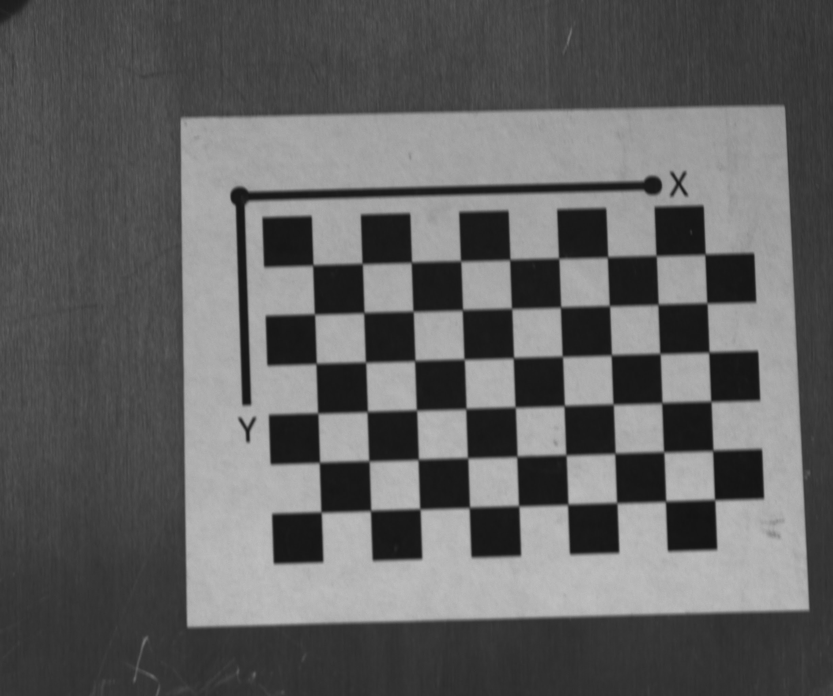
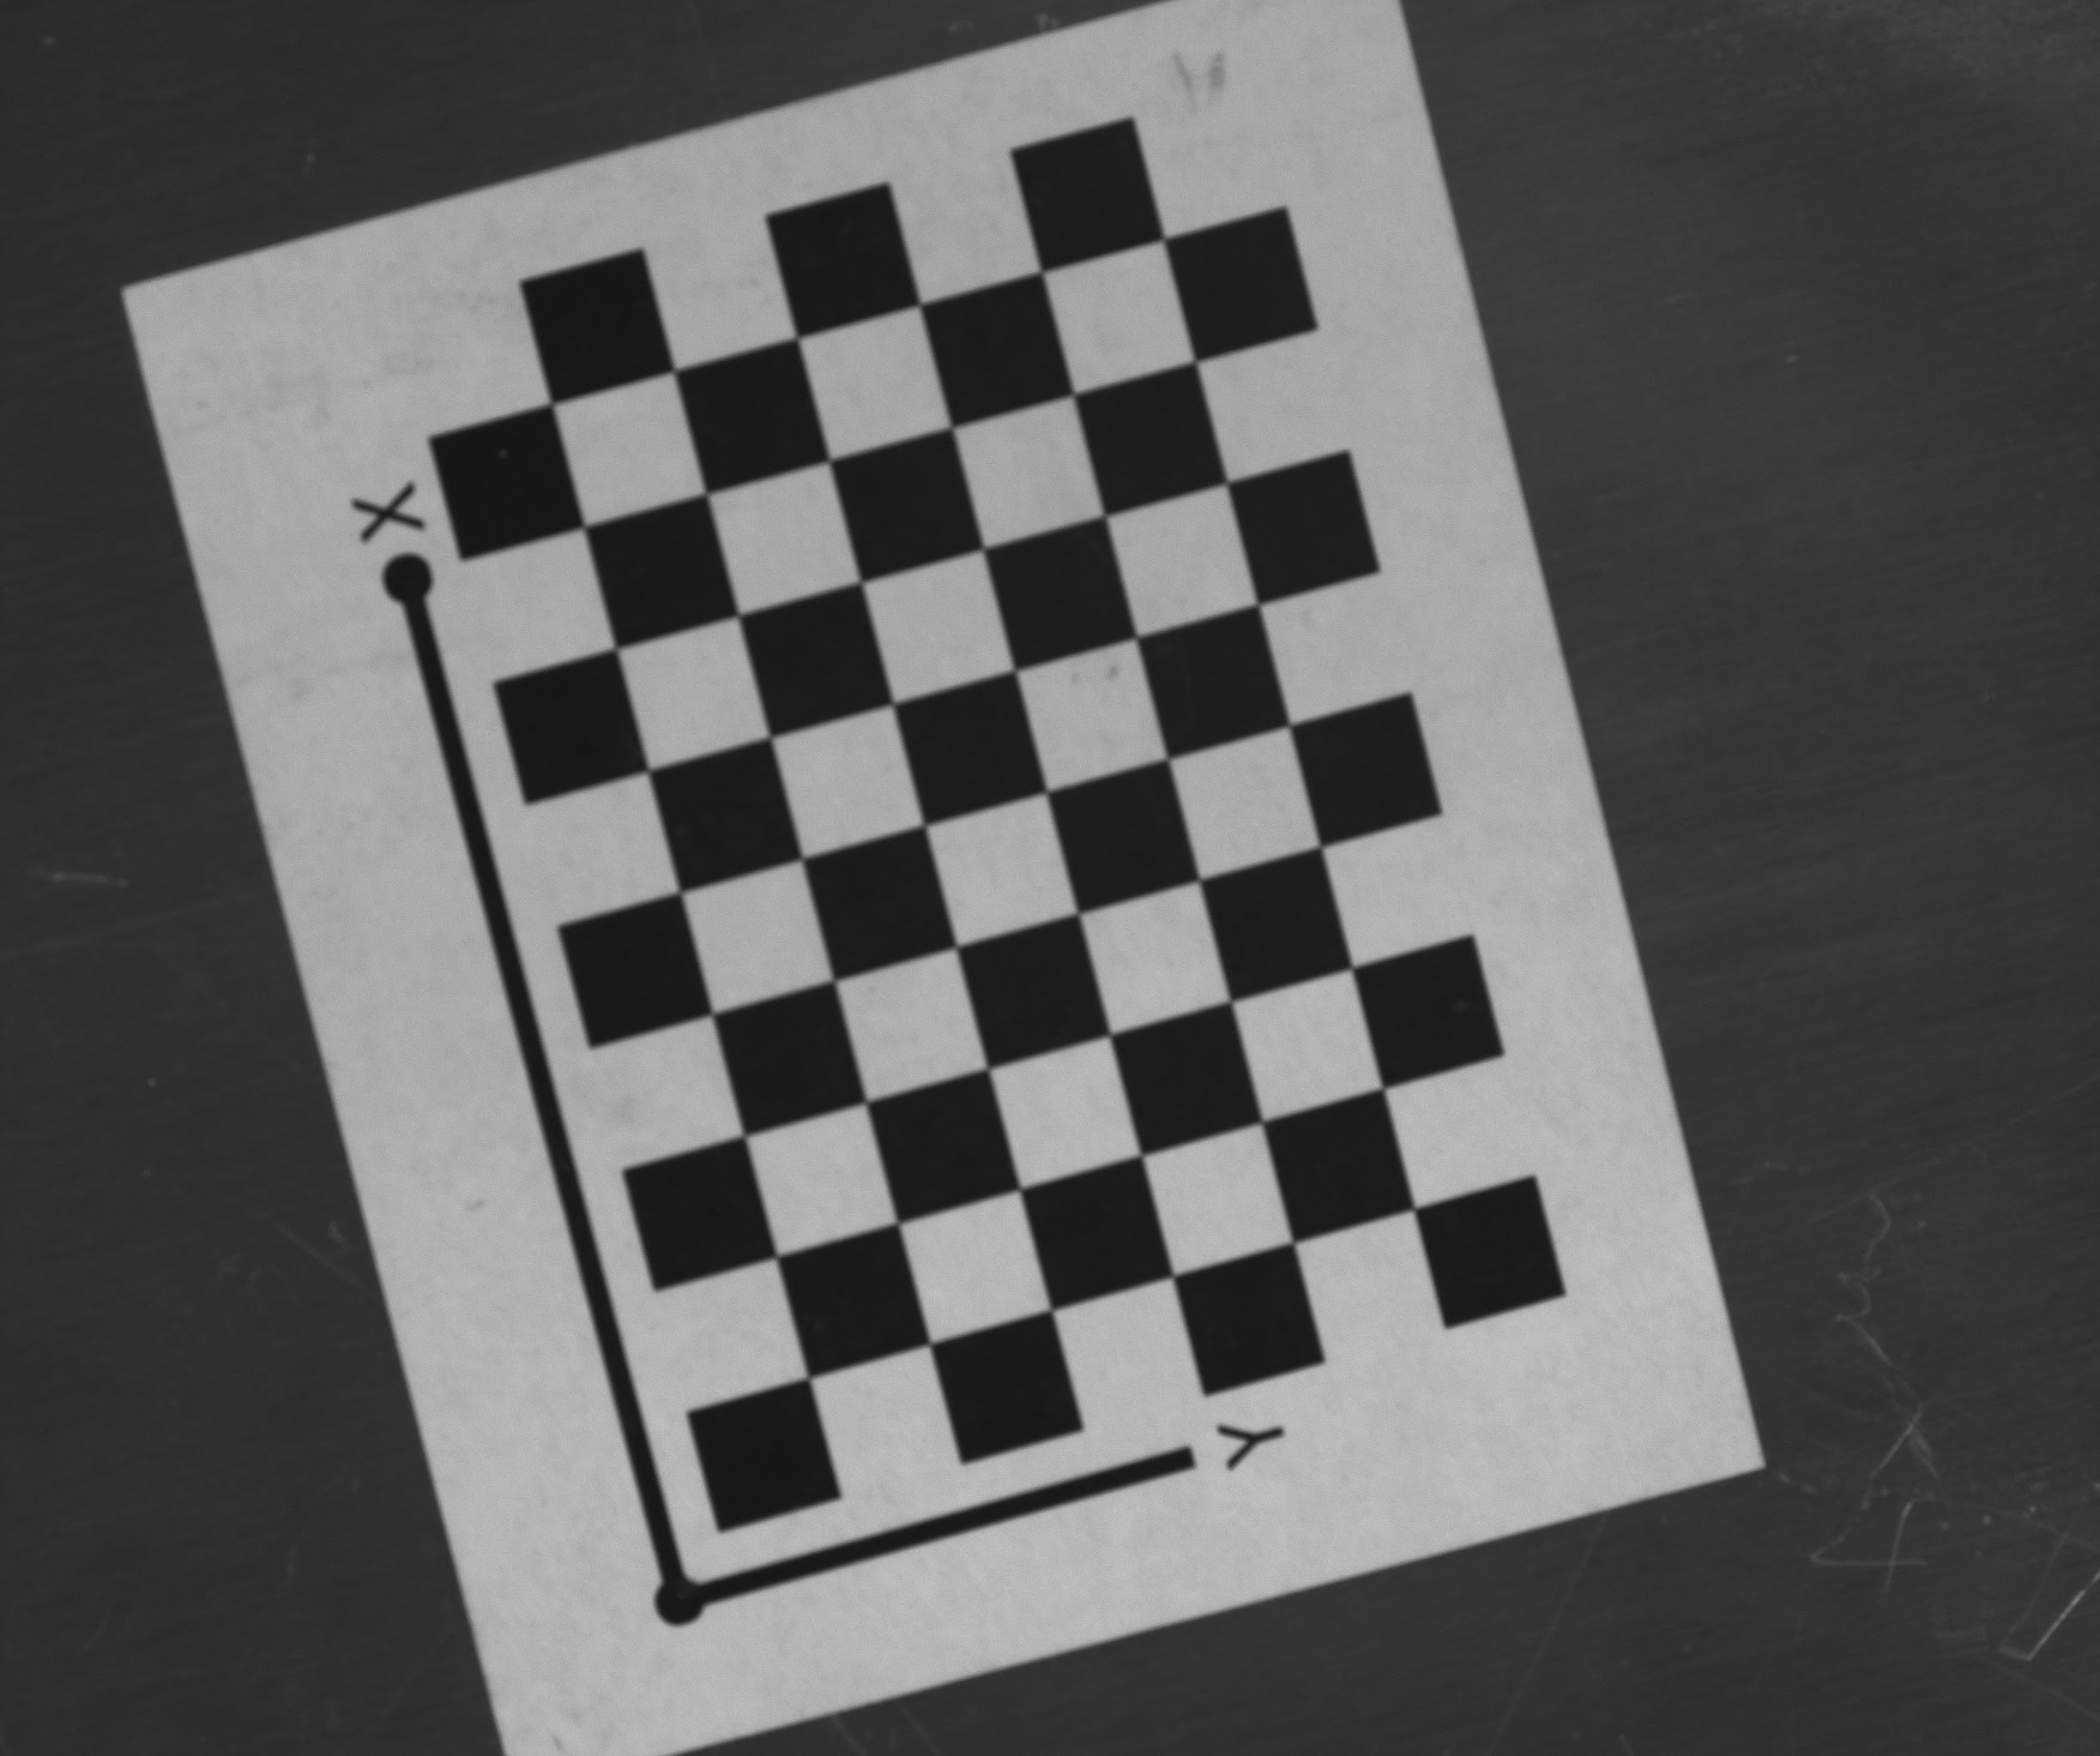
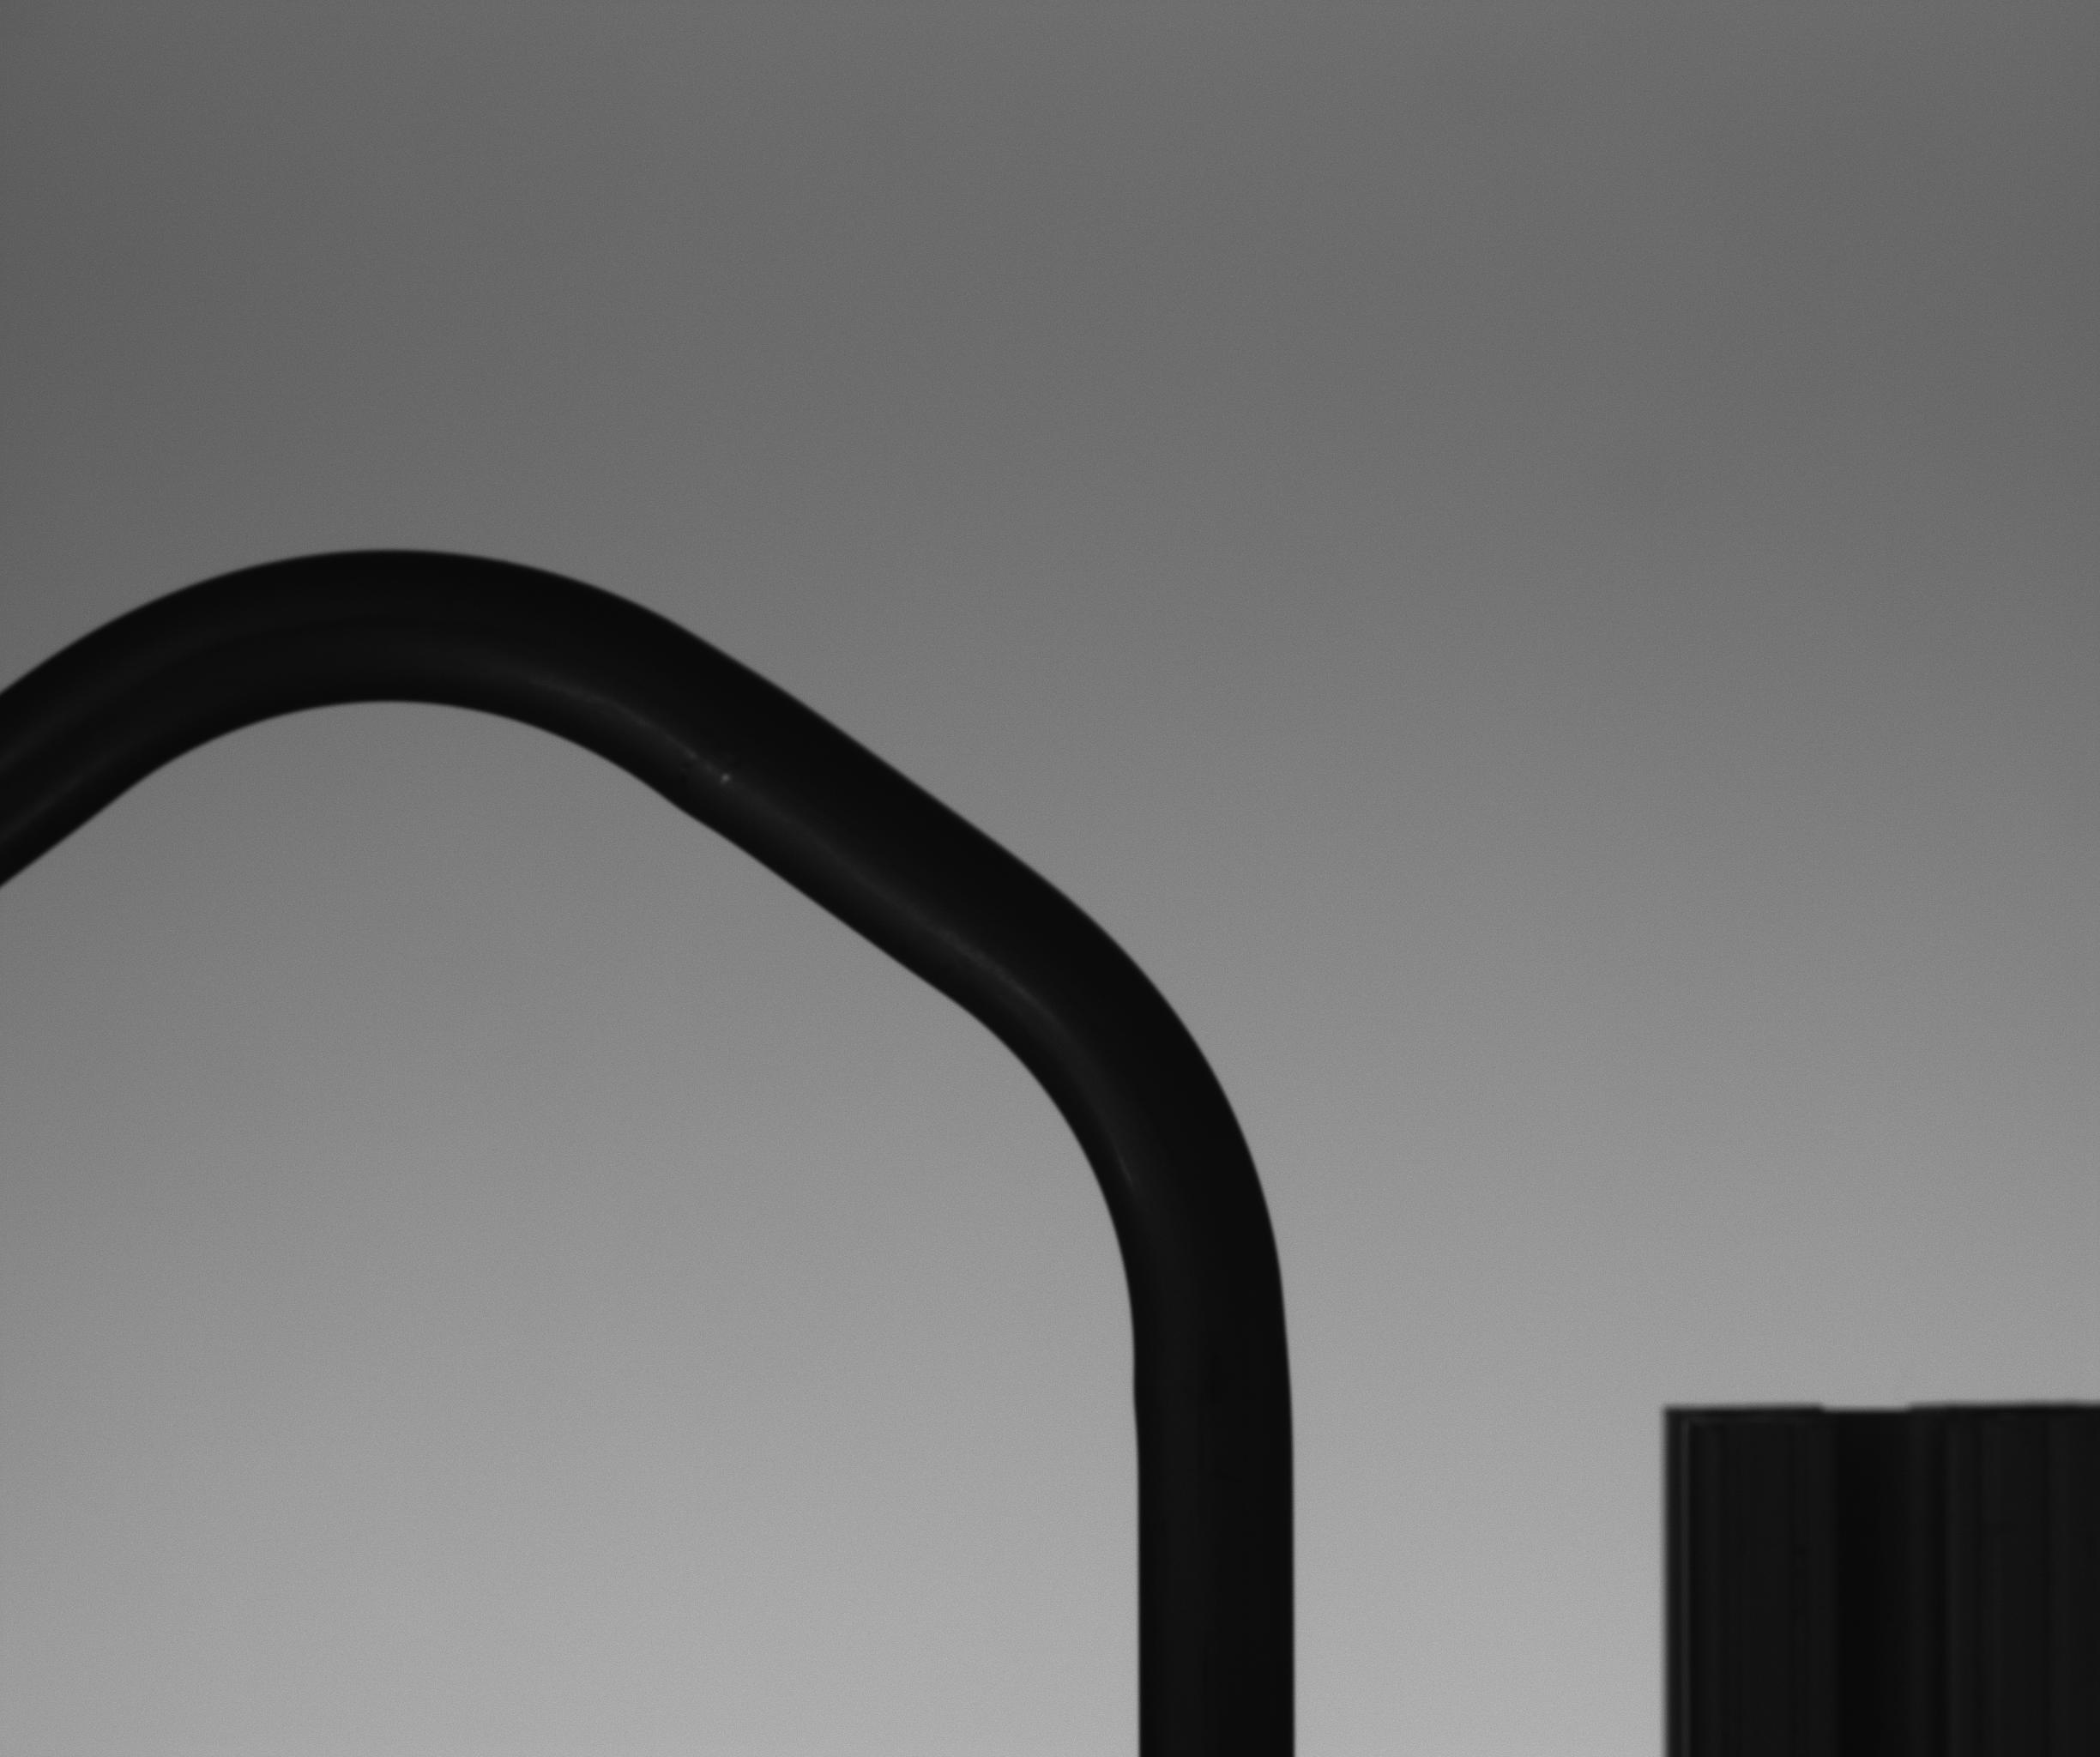
Camera Calibration
Capturing checker board images using SpinView software and performing calibration in MATLAB to get camera parameters like focal length, principal point etc.
This avoids the distortion caused by the camera.
This is followed by image acquisition for angle calculation.
30 such images...

Slide 5
Angle Calculation: Previous Work
Setup image
Image subtraction
Binarized
Centerline
Line fitting
Tube image
Angle Calculation

Slide 6
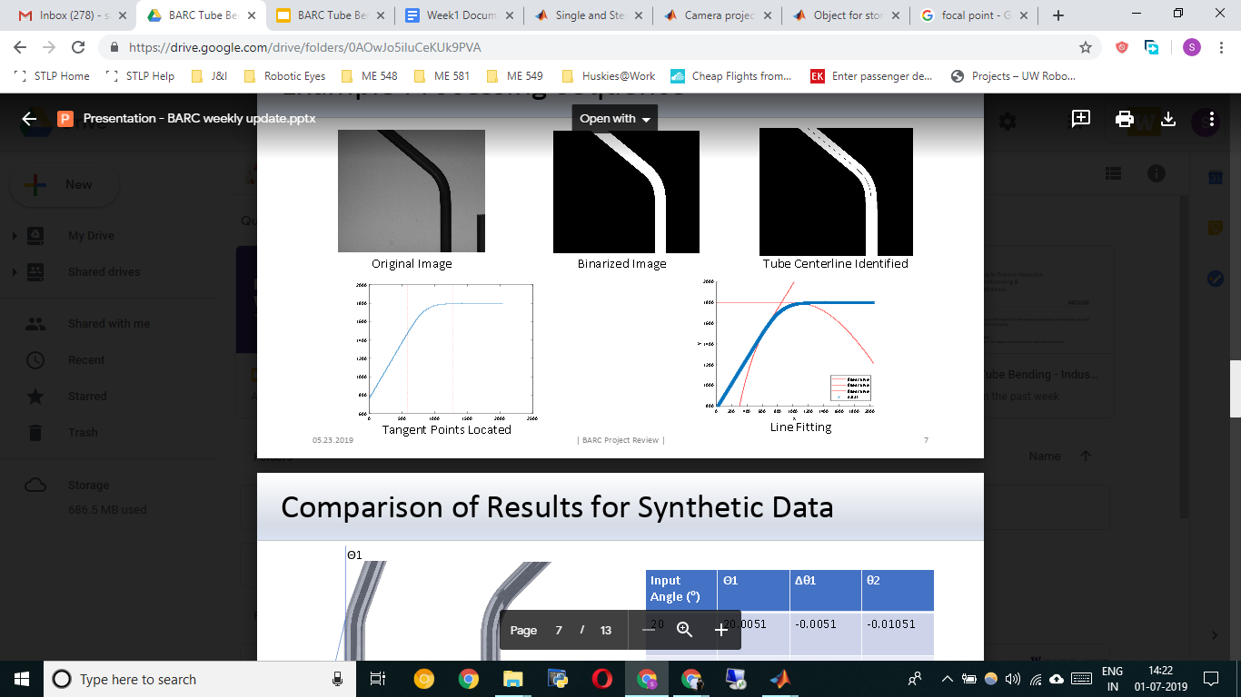
Previous Work : Centerline Approach
Obtaining a centreline of the tube using row/column slicing.
Calculate the tangent points on the centerline by choosing breakpoints. [ Tangent points are points where the angle starts to change]
Perform linear curve fitting at the tangent points and the angle of intersection of the tangent lines will provide the angle of bend.

Slide 7

Centerline: Slicing Method
After getting the binarized image, do a row/column slicing and average the indices to get the centerline of the tube.
Row Slicing

Slide 8
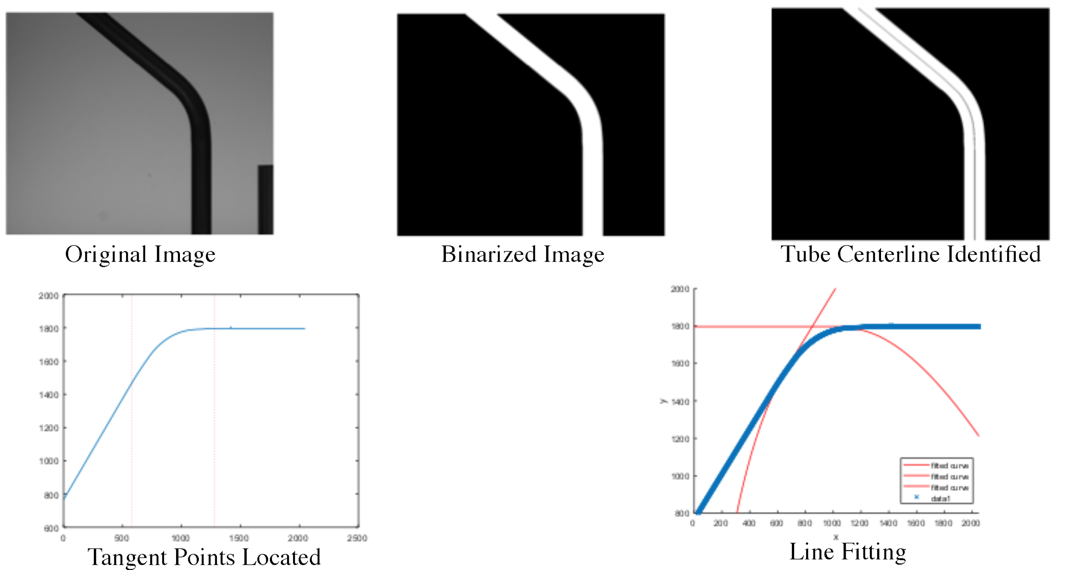
Successful trial (Done Previously)

Slide 9
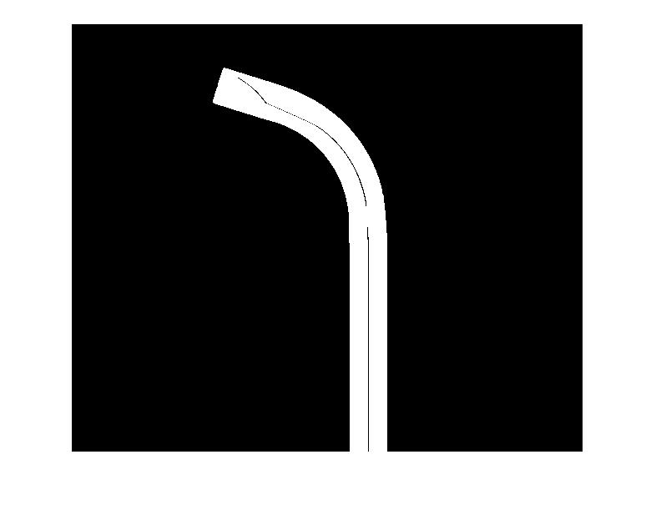
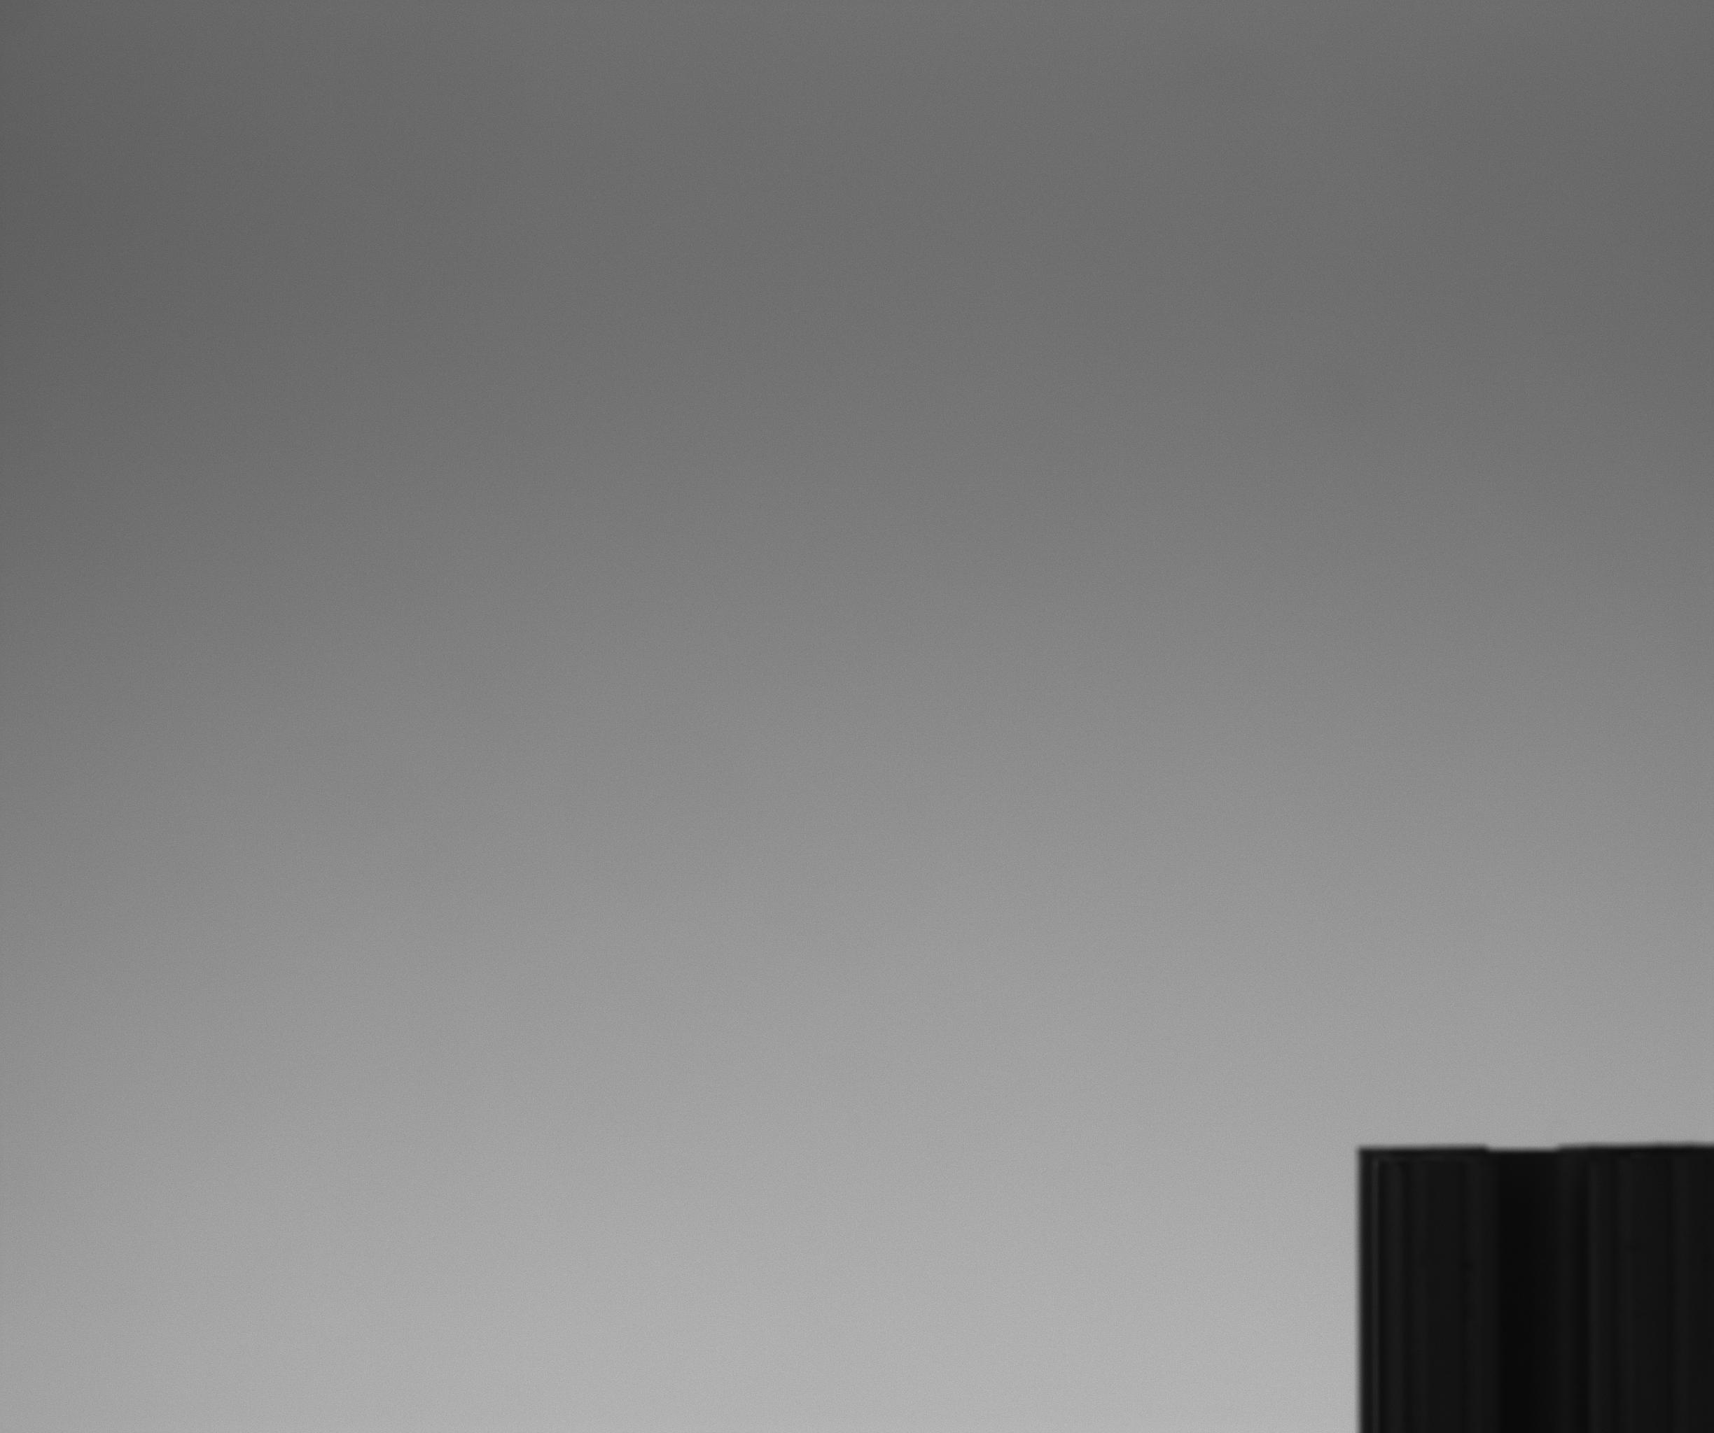
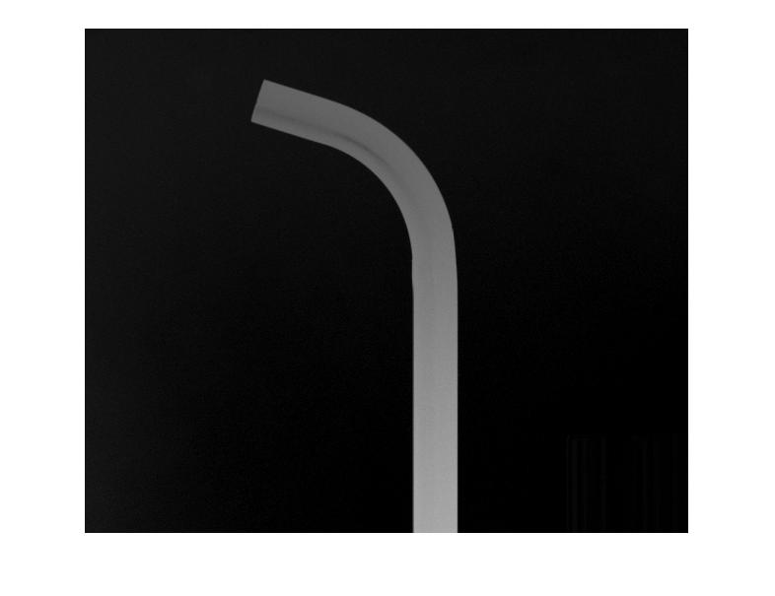
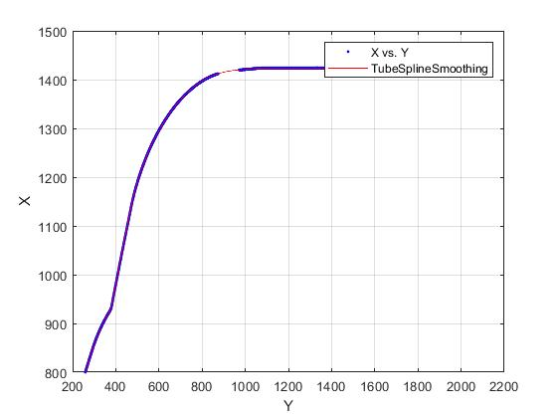
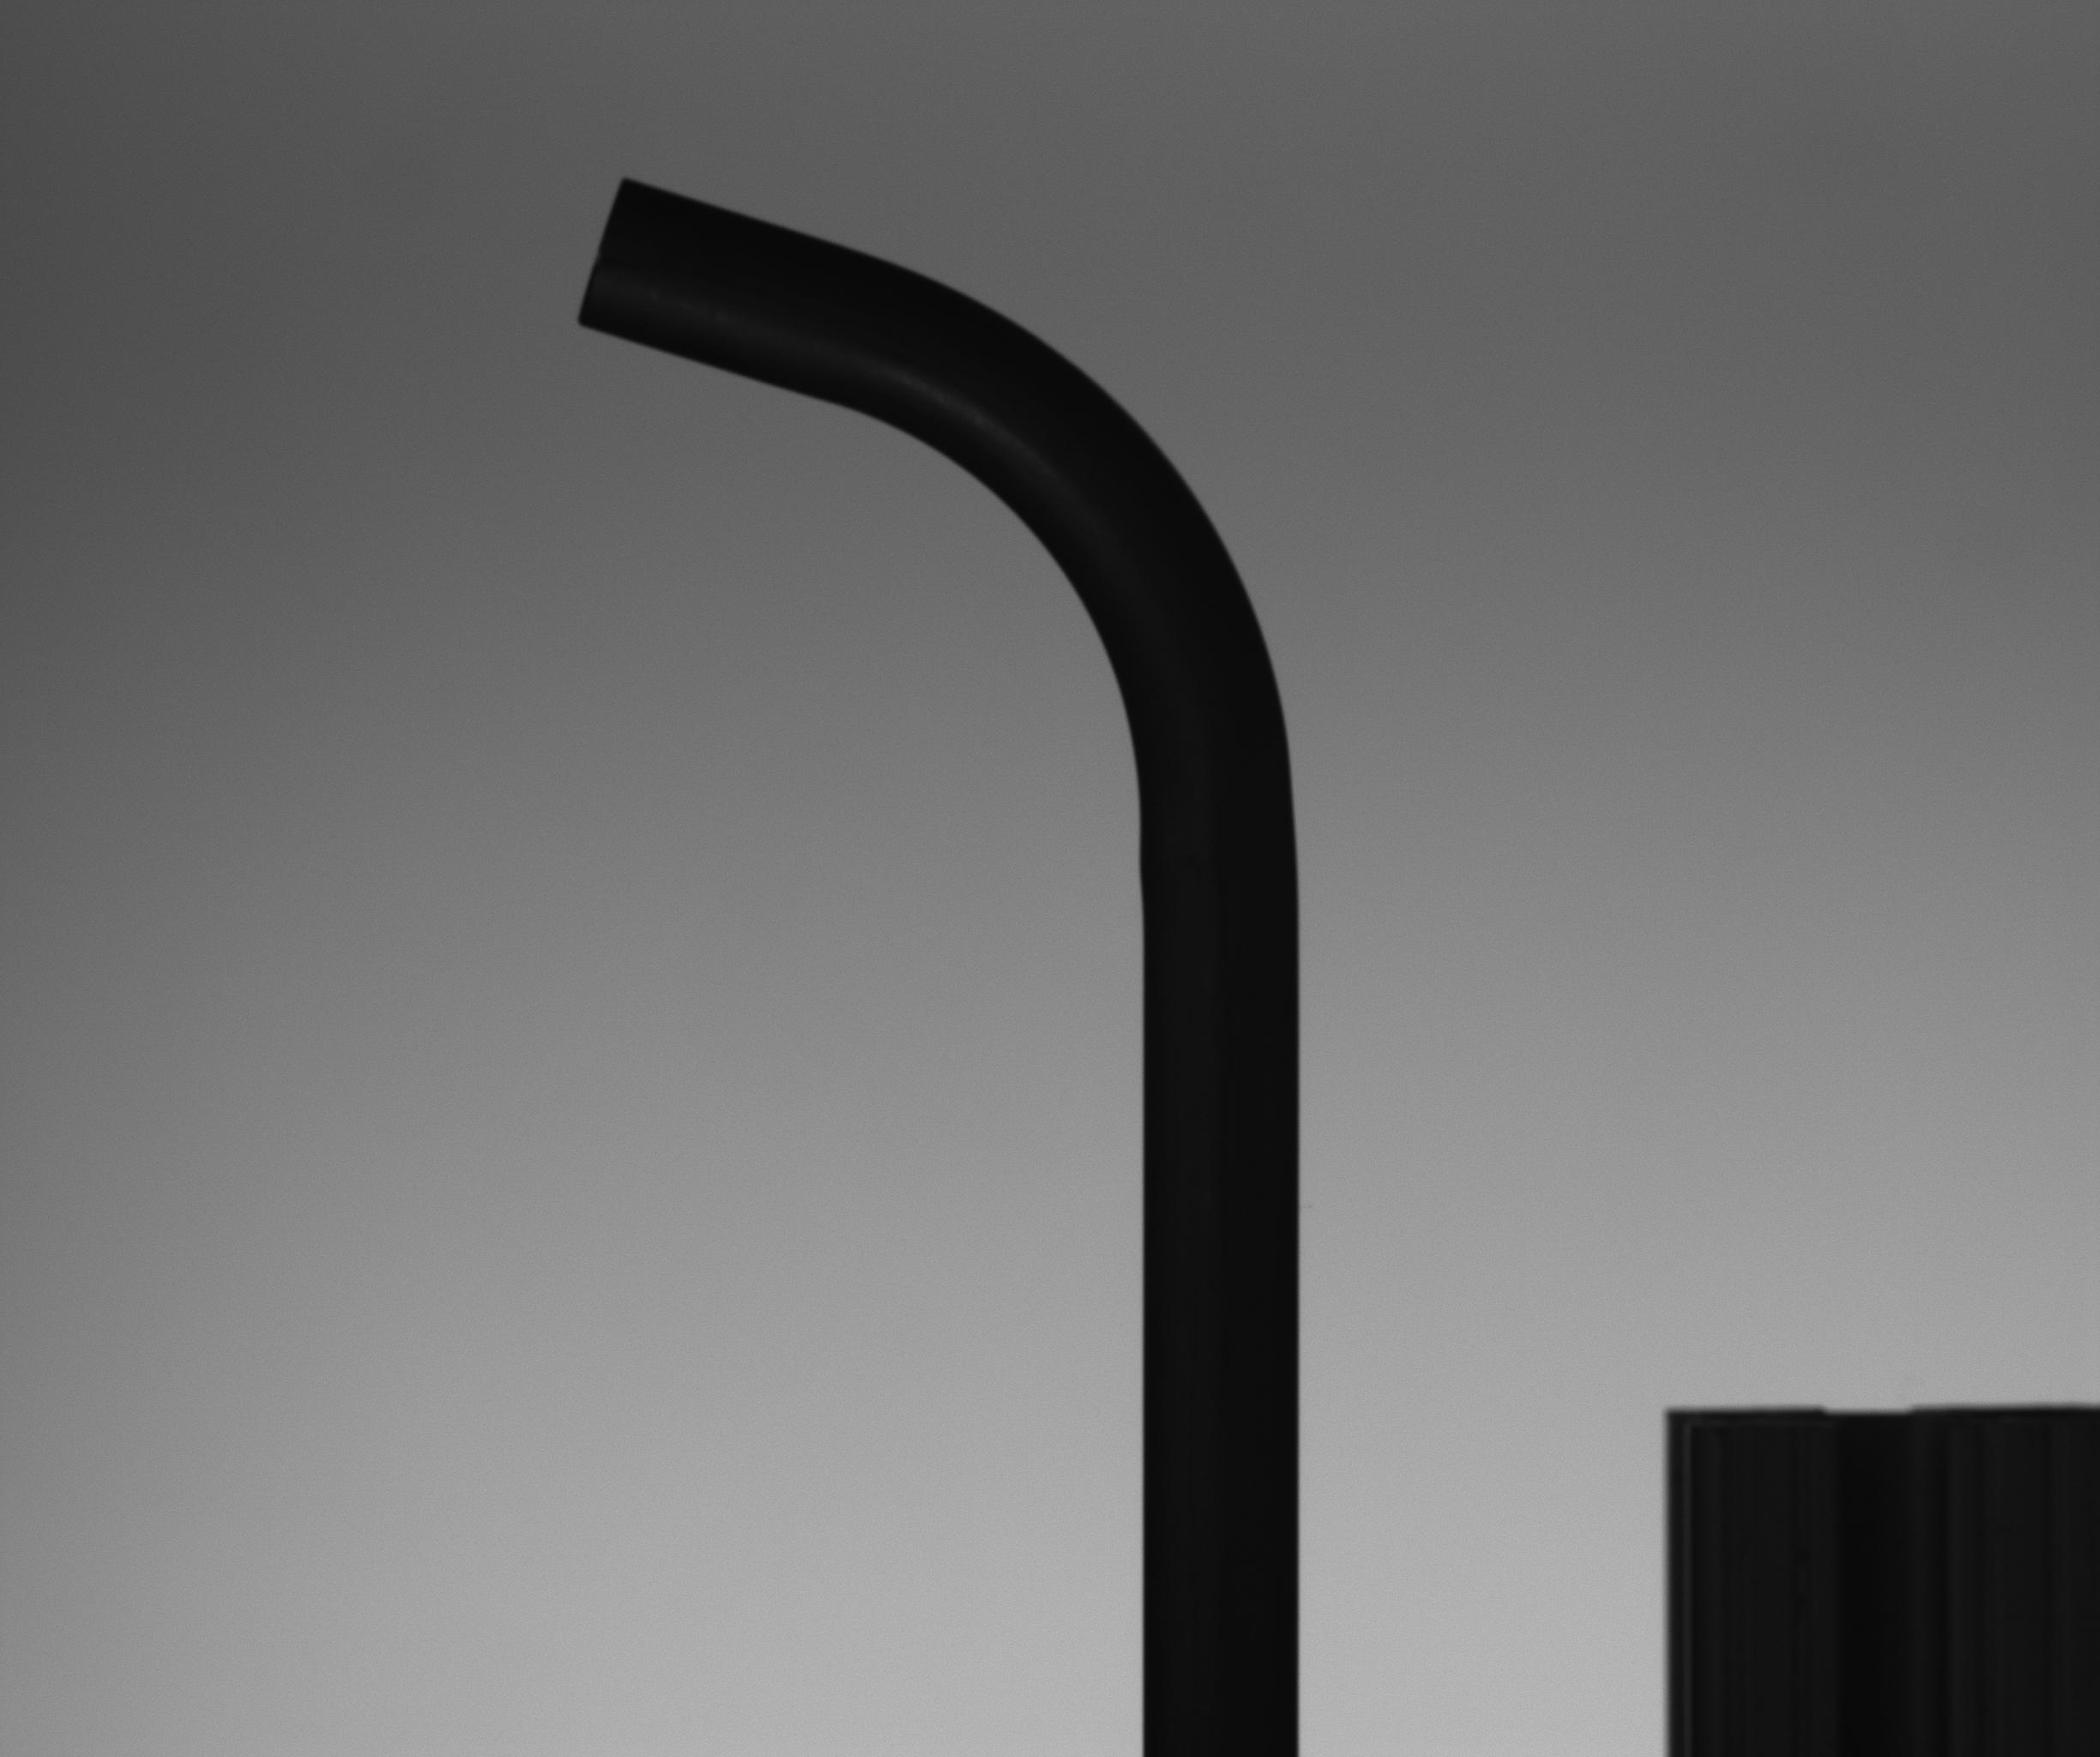
Unsuccessful trial (Our attempt at centerline)

Slide 10
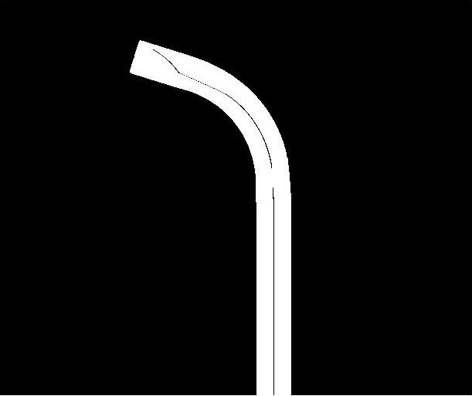
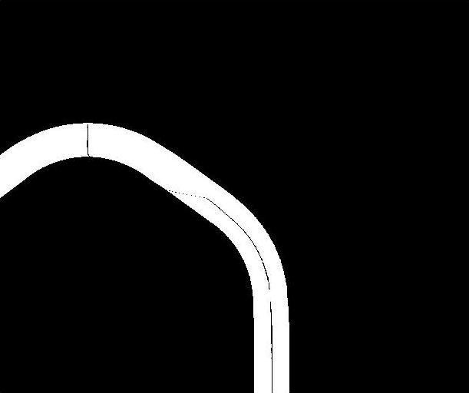
Slicing error: Part 1
Part 1 Bend 1
Part 1 Bend 2

Slide 11
Previous Approach: Insights
Pros:
Straightforward and easy to understand
Fairly small run time
Cons:
Centerline through slicing approach does not work for multiple bends or large bend angles hence it is not robust and is unreliable.
Centerline method in general is susceptible to error as edge noise can affect the centerline.

Slide 12
Angle Calculation: Current Approach
Setup image
Image subtraction
Binarized
Edge Detection
Line fitting
Edge Detection
Line Fitting to straight sections of edges (4 lines)
Angle calculation between the fitted lines
Tube image
Angle Calculation

Slide 13
Why Edge Detection is better?
Edge detection is straightforward and more robust to noise.
Individual edge usually give better result than the average of two edges.
Easier for automation in the future.

Slide 14
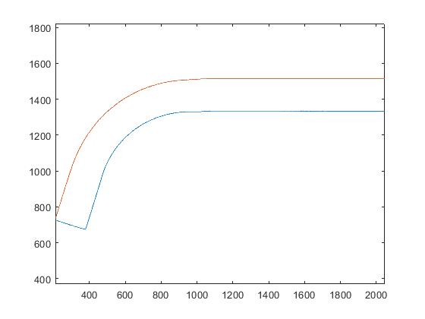
Results: P1B1
Least error edge - Left
Error value - 0.0101 deg
Binarized Image
Edge Detection plot

Slide 15
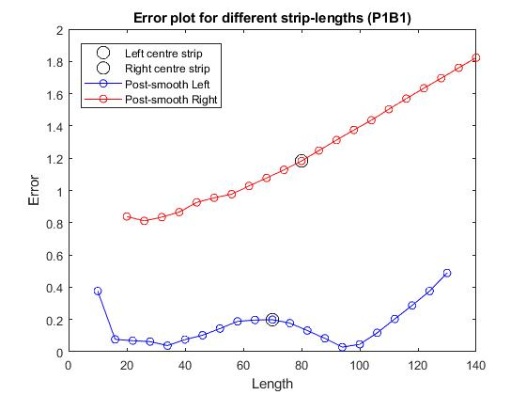
Results: P1B1 Error Plot

Slide 16

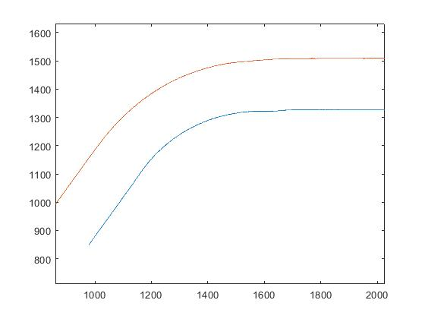
Results: P1B2
Least error edge - Right
Error value - 0.5170 deg
Binarized Image
Edge Detection plot

Slide 17
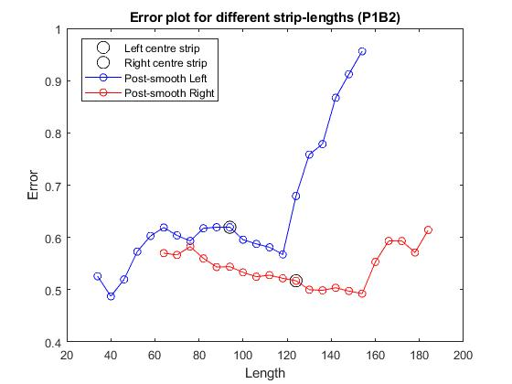
Results: P1B2 Error Plot

Slide 18

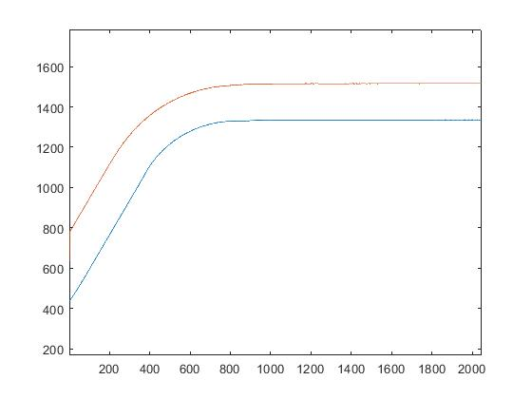
Results: P2B2
Least error edge - Left
Error value - 0.0022 deg
Binarized Image
Edge Detection plot

Slide 19
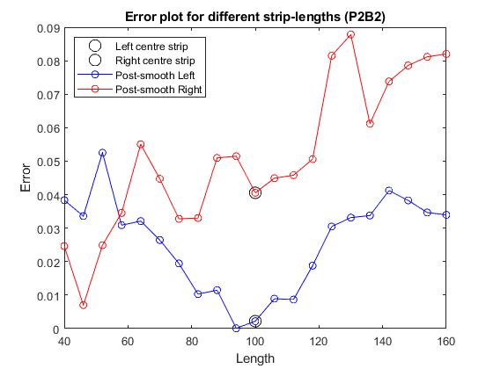
Results: P2B2 Error Plot

Slide 20

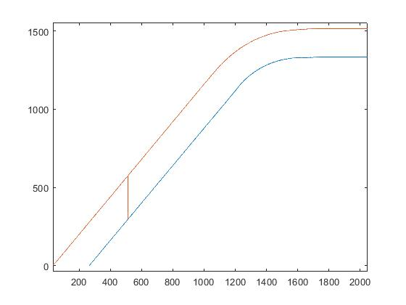
Results: P2B3
Least error edge - Left
Error value - 0.0277 deg
Binarized Image
Edge Detection plot

Slide 21
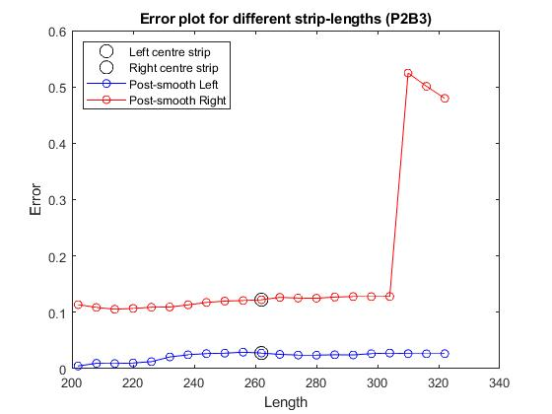
Results: P2B3 Error Plot

Slide 22

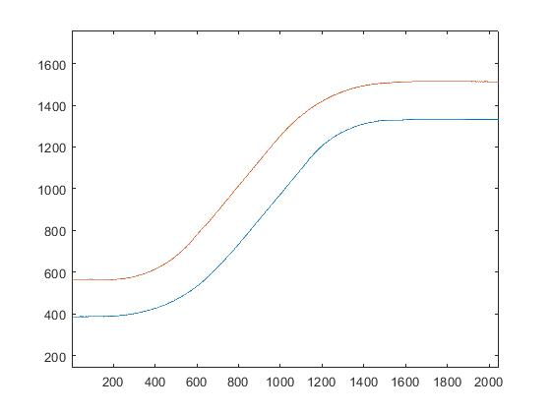
Results: P2B4
Least error edge - Right
Error value - 0.0432 deg
Binarized Image
Edge Detection plot

Slide 23
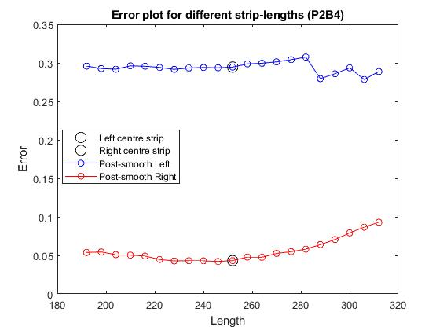
Results: P2B4 Error Plot

Slide 24
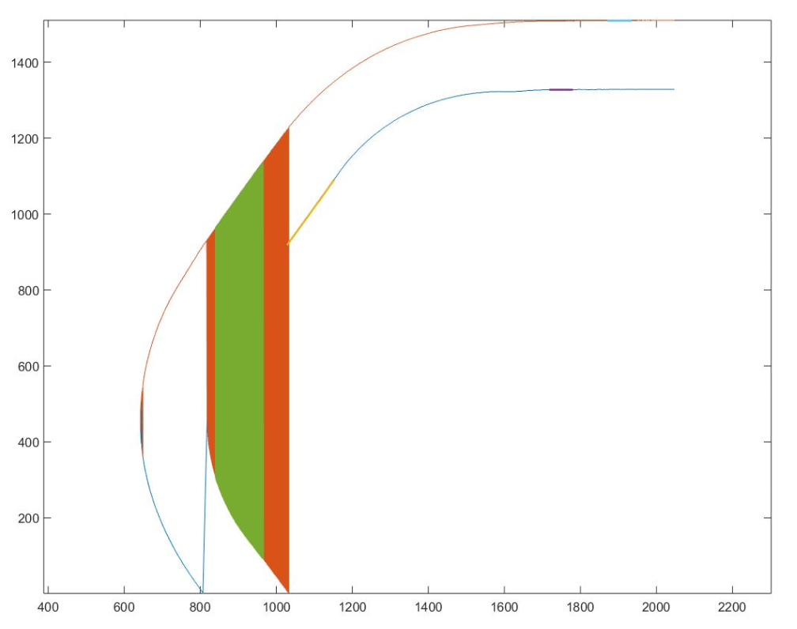
Challenges of Current Approach
Edge separation is not robust:

Slide 25
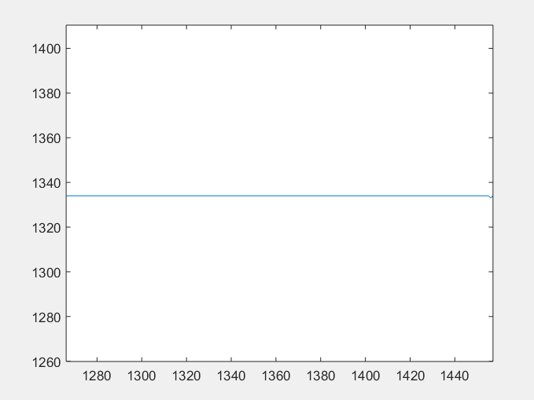
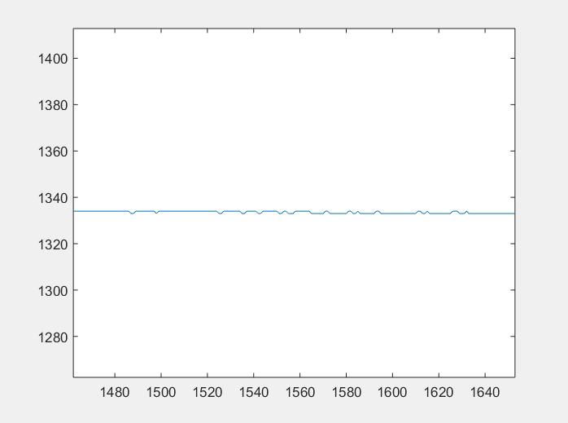
Challenges of Current Approach
Choosing sections of the edges to fit lines to is difficult:
Clean Section: Noisy Section:

Slide 26
Future Work
For now we will work on the ideal case and keep our parameters constant. The next steps would be:
Make edge detection Robust
Automate choosing the sections of the edges to fit lines to and calculate angle
After the ideal case works perfectly we will vary parameters and add noise.

